Slide 1
TSCF 2016 Shipbuilders Meeting Presentation
Application of New Common Structural Rules on Aframax Tankers
Presented by Cai Shijian
October 26th, 2016

Slide 2
Agenda
Introduction
New design trends for oil tankers
Prescriptive calculation for Aframax tanker
Direct strength analysis for Aframax tanker
Items to be discussed
Conclusion

Slide 3

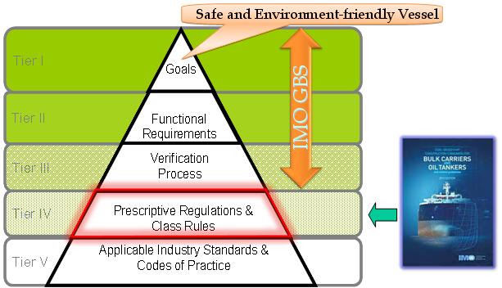
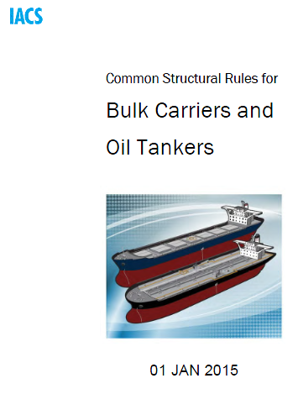
Introduction

Slide 4
Introduction
CSR-OT
CSR-BC
1 July 2015
(RCN1 of the 2010 CSRs)
EAG review
Review for RCP
1July
1Apr.
1
2
31 Aug.
New CSR
CSR-H Release
2010 2011 2012 2013 2014 2015 2016
CSR-H
1st Draft Rules
CSR-H
2nd Draft Rules
External review period
Technical Committee review
IACS adoption
Entry into force
Deadline of submission to IMO for GBS verification
(two steps)
GBS to start application to OT and BC
(1 July 2016)

Slide 5
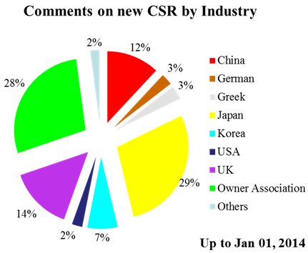
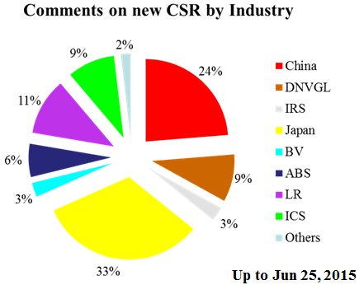
Introduction
Development Period for new CSR
(before 01 Jan, 2014)
Maintenance Period for new CSR
(after 01 Jan, 2014)

Slide 6
Introduction
Economy,
Energy cost,
Performance,
Safety,
…
Owner
Society
Good ship design
Rules
Environment protection, Occupational health,
…
New CSR,
Ice class,
SOLAS,
MARPOL,
…
Industry
Cost, Workload, Optimization,
Innovation,
…

Slide 7
New design trends for oil tankers
Eco-friendly or green ship designs, low EEDI:
Wave resistance
Leadge-Bow design
Min thickness
Rule length
Hull girder loads
Block coefficient
Thin hull line design
Msw-hog
Bending & ultimate strength problem (aft CH & ER)
Diameter of propeller
Propulsion efficiency
Propeller exciting force
Hull vibration
Energy-saving device
Energy cost
Potential safety risks

Slide 8
New design trends for oil tankers
Eco-friendly or green ship designs, low EEDI:
Optimal design of superstructure
Wind resistance
Vibration problem
Environmental protection
Cofferdam
Steel weight
Compartment arrangement problem
Requirement of noise level
Occupational health
Steel weight

Slide 9
Target ship
Aframax tanker with plane bulkheads
Parent ship
New ship
CSR-OT
HS steel rate: 68%
No ice class
CSR-H
HS steel rate: 55%
Ice class: LR 1A
Strengthen of side shell along the whole ship length, especially for the fore ship

Slide 10
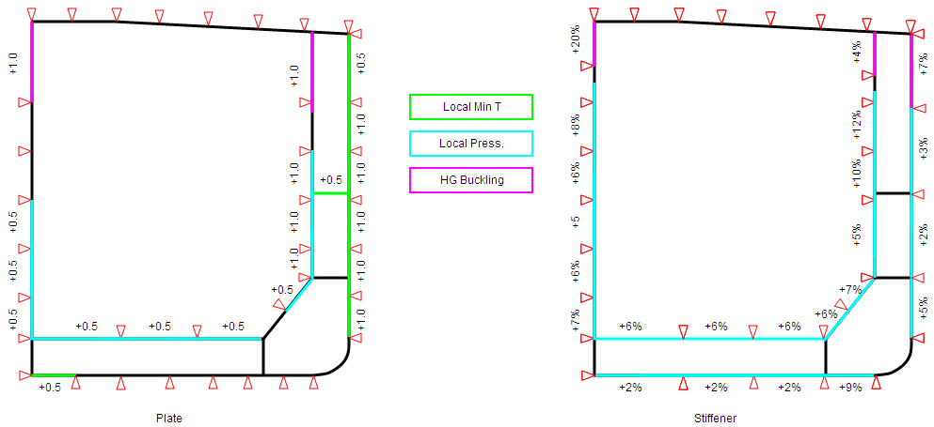
Prescriptive calculation for Aframax tanker
Impact on scantlings
  Use model of the parent ship
  No impact on scantlings for hull girder strength excluding buckling
midship cargo hold region

Slide 11
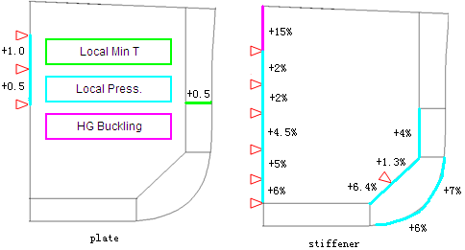
Prescriptive calculation for Aframax tanker
Impact on scantlings
foremost cargo hold region

Slide 12
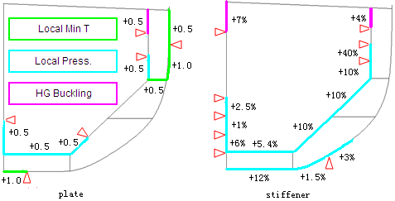
Prescriptive calculation for Aframax tanker
Impact on scantlings
aftmost cargo hold region

Slide 13
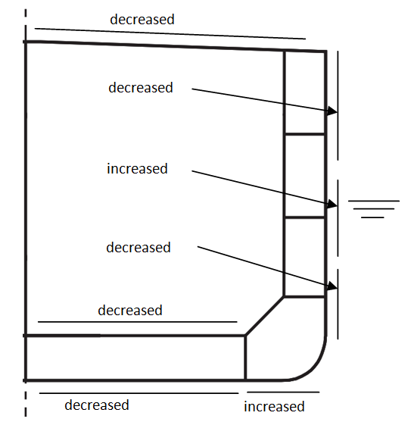
Prescriptive calculation for Aframax tanker
Fatigue strength
Be cautious to the holes or welded joints on main deck
Deck plate thickness
number of end brackets
number or size of end brackets
Construction workload

Slide 14
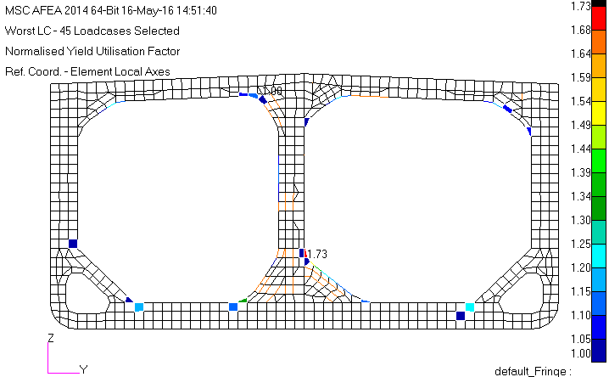
Direct strength analysis for Aframax tanker
Cargo hold analysis
  Midship cargo hold region
    Use model of parent ship
    Yielding
+60%~90%
fine mesh

Slide 15
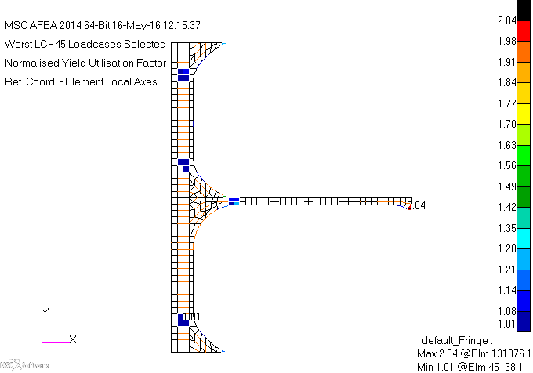
Direct strength analysis for Aframax tanker
Cargo hold analysis
  Midship cargo hold region
    Yielding
+2mm

Slide 16
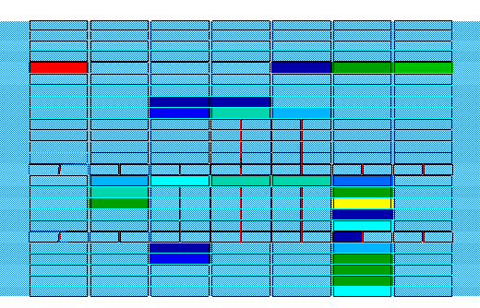
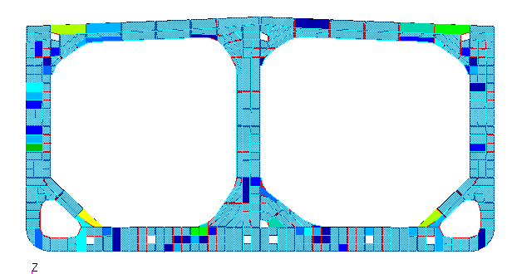
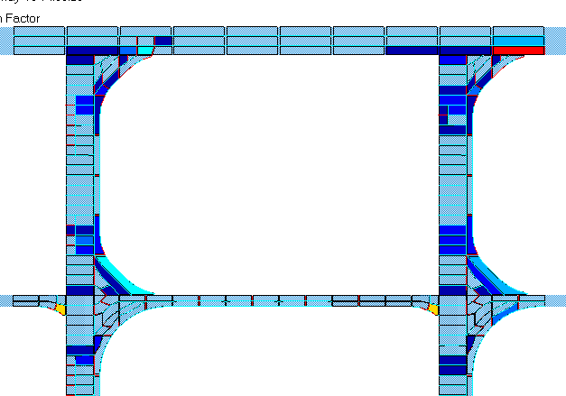
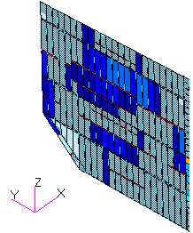
Direct strength analysis for Aframax tanker
Cargo hold analysis
  Midship cargo hold region
    Buckling
Centerline BHD: add stiffener; change material
Floor: +1mm; others: add stiffener
End of shear span of transverse stringer: +2mm;
Others: add stiffener
Transverse BHD: +0.5~2mm (port, upper)

Slide 17
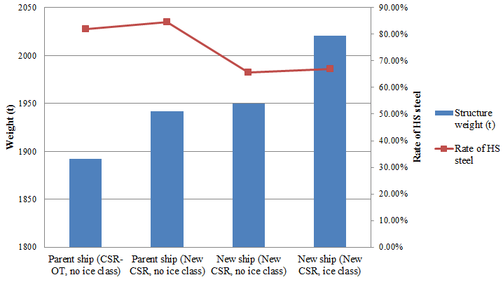
Direct strength analysis for Aframax tanker
Cargo hold analysis
  Midship cargo hold region
    Structure weight comparison

Slide 18
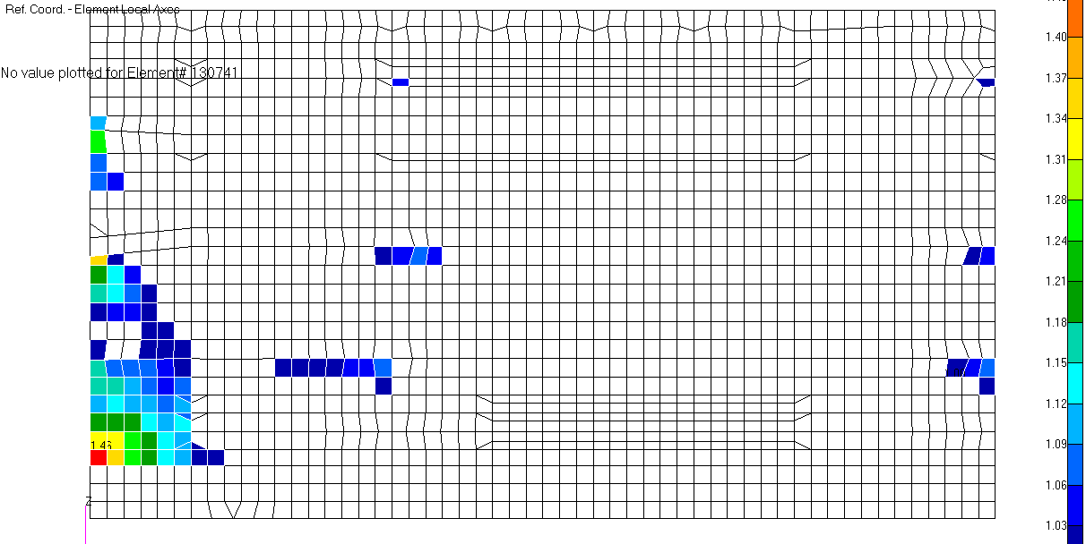
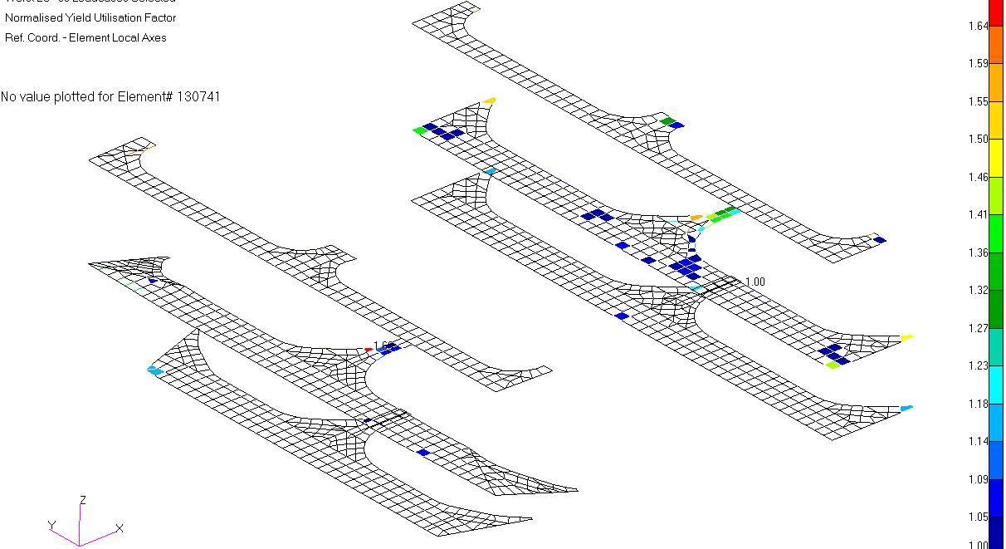
Direct strength analysis for Aframax tanker
Cargo hold analysis
  Foremost cargo hold region
    New ship model
  Aftmost cargo hold region
    New ship model without ice class (yielding)
Strengthen due to ice class
Different frame system
Few areas need to be reinforced
Lower rate of HS steel
Centerline BHD: +2~8mm
Horizontal stringer: similar to midship

Slide 19
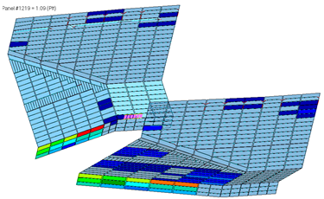
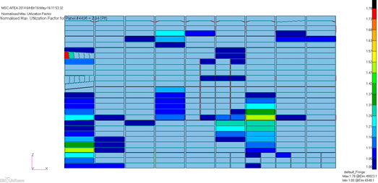
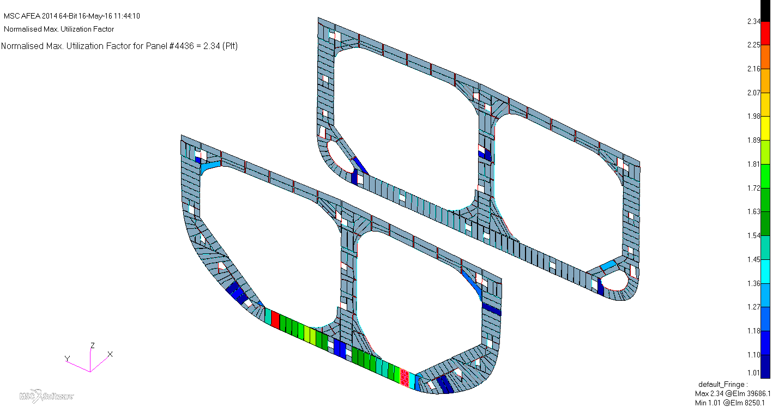
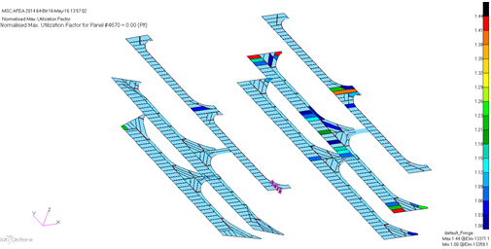
Direct strength analysis for Aframax tanker
Cargo hold analysis
  Aftmost cargo hold region
    New ship model without ice class (buckling)
Floor: +1~2mm and stiffener
Centerline BHD: add stiffener; +1.5~2mm
Side bottom girder: add half frame; +0.5mm;
Others: add stiffener
Horizontal stringer: add stiffener; +0.5mm

Slide 20
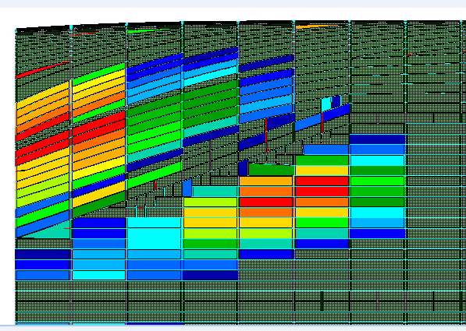
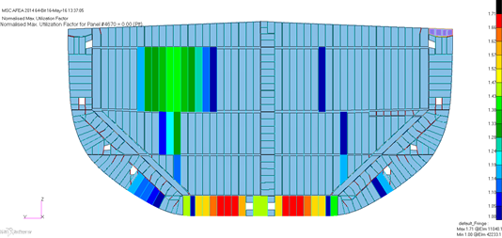
Direct strength analysis for Aframax tanker
Cargo hold analysis
  Aftmost cargo hold region
    New ship model without ice class (buckling)
    Impact of ice class on scantlings: about 60 ton for side shell
    Impact of ice class on results shown above is not obvious
Shell: +3mm, or +1mm and stiffener
Transverse BHD: +0.5~1mm (port, upper); add stiffener

Slide 21
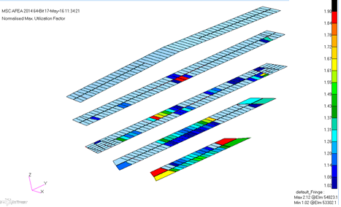
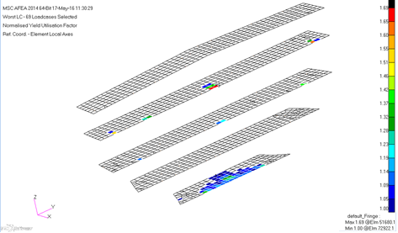
Direct strength analysis for Aframax tanker
Cargo hold analysis
  Engine room region
    Length of evaluation area: 15% of the aftmost cargo hold length excluding slop tanks
    Scantlings increased for platform and inner bottom
    The effect of ice class on the results is not obvious

Slide 22
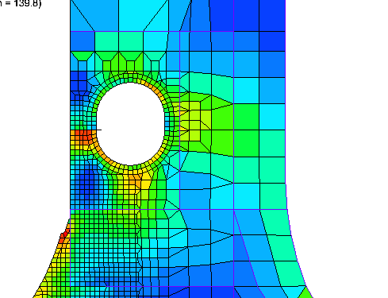
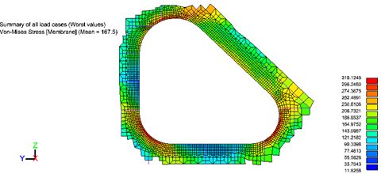
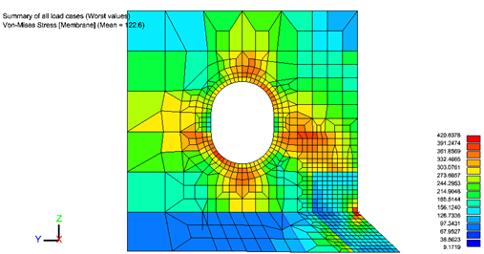
Direct strength analysis for Aframax tanker
Fine mesh analysis
  Opening and manhole areas
  Hopper knuckles
Manhole of side vertical web near upper knuckle: replace manhole stiffener with face plate
Manhole of vertical PSM on centerline BHD near large bracket toe: replace manhole stiffener with face plate, and increase web thickness
Hopper web to face plate: increase the breadth of face plate
Fatigue complied
Fine mesh criteria
Thickness
Midship:
20%
material yield strength
Foremost cargo hold:
Tank load
Thickness

Slide 23
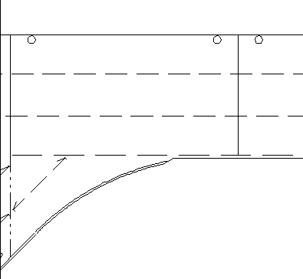
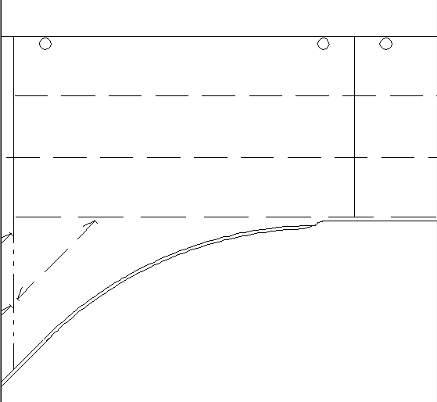
Direct strength analysis for Aframax tanker
Fatigue analysis
  Hopper knuckles
  Bracket toe
Lower knuckle |  | Upper knuckle
Hot spot location | T_{F} (year) | Hot spot location | T_{F} (year)
HS1: inner bottom | 27 | HS1: side stringer | 300
HS2: hopper slopping plate | 27.2 | HS2: hopper slopping plate | 25.1
HS3: hopper web | 60 | HS3: transverse web, below stringer | 35.7
HS4: double bottom floor | 36.9 | HS4: transverse web, above stringer | 37.0
HS5: side girder | 115 | HS5: inner hull longitudinal bulkhead | 25.5
HS6: scarfing bracket to the inner bottom | 132
Middle stringer
Structure | Hot spot location | Type | T_{F} (year)
Backing bracket | Hot spot 1: free edge of bracket | free edge | 57
 | Hot spot 2: inner hull at bracket toe | type a | 49
 | Hot spot 3: transverse bulkhead at bracket toe | type a | 27
Stringer toe | Hot spot 1: inner hull at bracket toe | type a | 40
 | Hot spot 2: toe in way of face plate termination | type b | 40
lowest side stringer

Slide 24
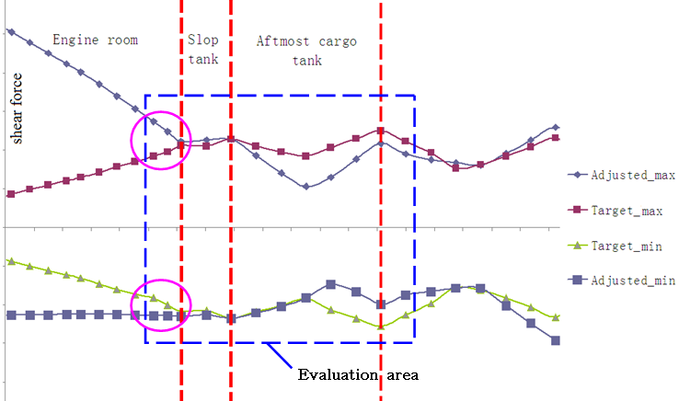
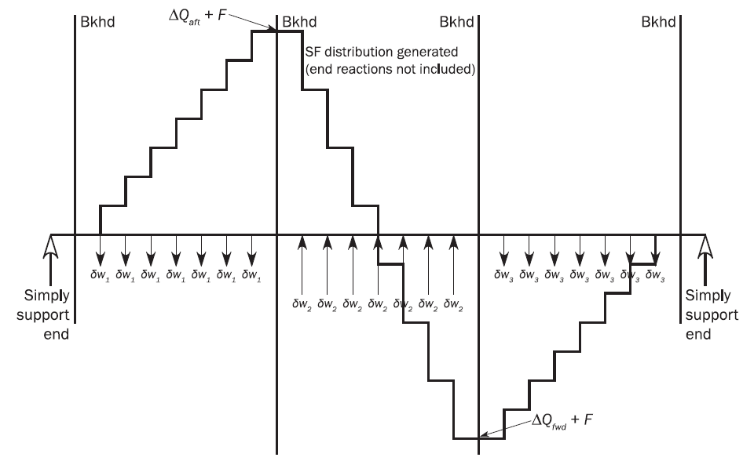
Items to be discussed
Shear force adjustment in FEA of aftmost cargo hold region
Suggestions: Modify the adjustment method of shear force distribution in ER area or don’t evaluate members in ER areas.
Notes:
New CSR gives equilibrium method for bending moment correction, but for shear force correction, the method is found to be only applicable for cargo regions not for other areas (including slop tank) because the target of shear forces is only at the location of transverse BHD.
But: The evaluation areas include “all hull girder longitudinal structural members aft of forward trans. BHD within the extent of 15% of aftmost cargo hold length excluding slop tanks”. It could be found that the adjusted model shear force curves in evaluation area after the forward transverse bulkhead of the machinery space exceed the target shear force curves. So the shear stress of longitudinal bulkheads in engine room may be too conservative. If the aftmost cargo hold is much longer, the affective area in engine room will be much larger. For VLCC, this phenomenon is much severer.

Slide 25

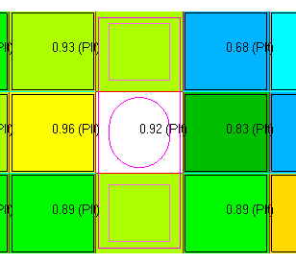

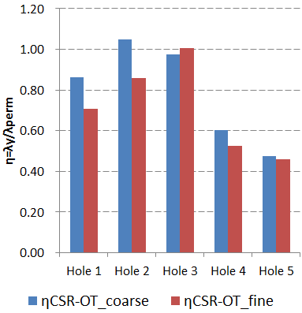
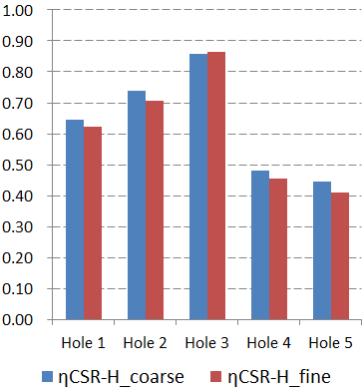
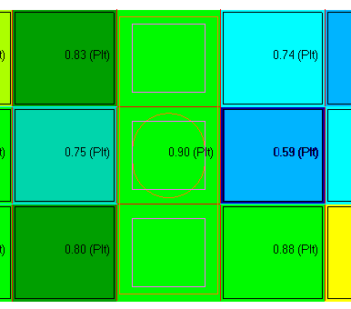
Items to be discussed
Buckling calculation of manhole area
Buckling
CSR-OT
CSR-H
Yieldling
Notes:
It is required that “Regardless of size, manholes are to be modeled by removing the appropriate elements” in new CSR. But the definition of manhole and what are appropriate elements are not clear!
There are huge workloads to model unclear manholes, especially in fore and aft cargo area; hole arrangement may be changed frequently during design stage.
For FE yield results：it is found that different methods with corresponding screening procedure for finemesh are acceptable and effective. It is not necessary to model manholes by removing the appropriate elements for FE yield analysis.
For FE buckling results: Only stress based method is used in new CSR for determining reference stresses, which will be sensitively based on stress. But in CSR-BC, displacement based method is used for buckling check around holes by removing elements. New reduction factors of web plate in way of opening are prescribed in new CSR. But it is found there would be different buckling results by different methods.
Our suggestion: IACS should determine which modeling method for holes are reasonable for buckling. If FE yield and buckling results are similar by different modeling methods, it is suggested that the modeling method of manholes are based on their sizes, but screening criteria for manholes could be adjusted.

Slide 26
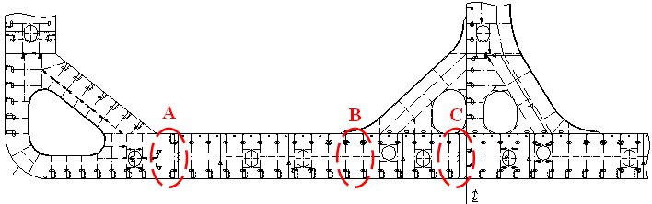
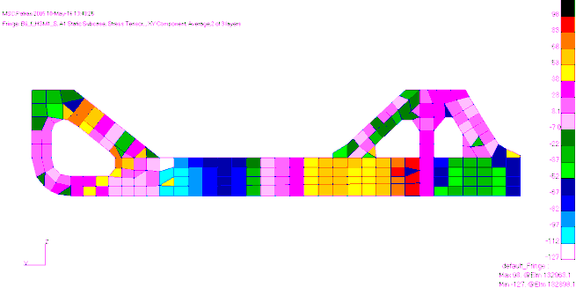
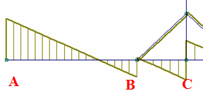
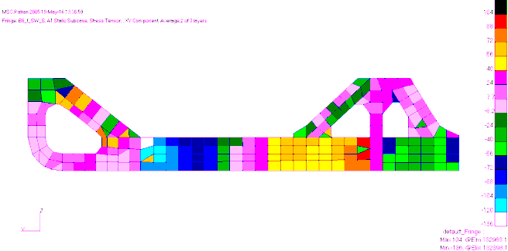
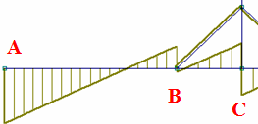
Items to be discussed
New inclined strut arrangement for bottom floor
Suggestions: shear strength at location C shall be checked in the prescriptive requirement
Notes:
With topological optimization, it is found that the arrangement of inclined strut for bottom floor with long shear span may be effective. MARIC has applied such arrangement in the design of a new Aframax tanker.It is found that the inclined strut can decrease the high stress at hopper knuckle end of bottom floor (A), but at the same time, the inboard end of bottom floor (C) should be paid more attention, because only the part of bottom floor between location A and location B will be checked in the prescriptive requirement.
From grillage analysis, it could be found that the shear force at location C is at almost the same level of that of location B. From cargo hold analysis, it could be found that the shear stress at location C is even larger that at location B, due to smaller thickness at location C than that at location B. The material at location C is normal steel, and the average shear stress may exceed the permissible shear stress for harbor condition. It is suggested that the shear strength at location C shall be checked in the prescriptive requirement.

Slide 27
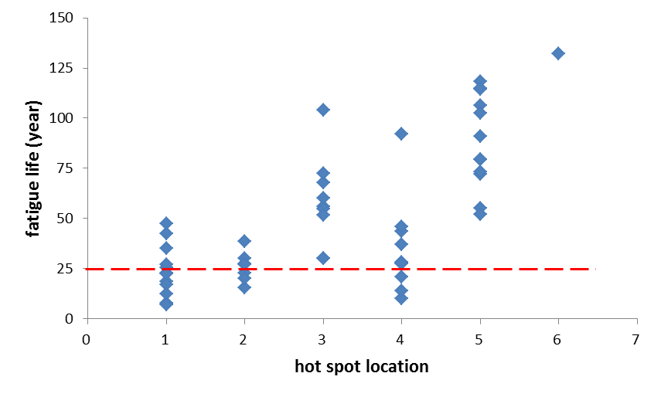
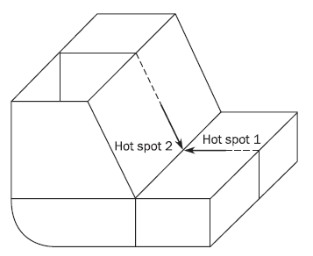
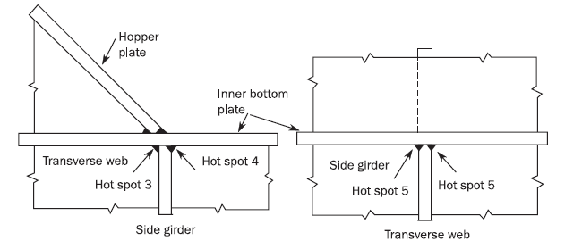
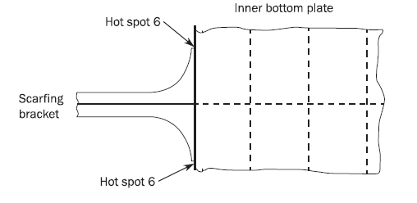
Items to be discussed
Selection of fatigue hot spot locations and hot spot type
  Different thicknesses different models or stress read out methods
Welded lower hopper knuckle
2
1
3
4
Notes:
There are some hot spot locations given in New CSR, and the amount is much more than that of CSR-OT. But it is found that not all the hot spot locations need to be check according to the consequence assessments.
For lower hopper knuckle area, 6 hot spots are required to do fatigue check. But it is found that only hot spot 1, 2 and 4 may be necessary. The results shown in the graph are calculated based on CSR-H 2015. The result may be reduced several years according to the urgent RCP 2016. So the hot spot 3 may also be necessary.

Slide 28
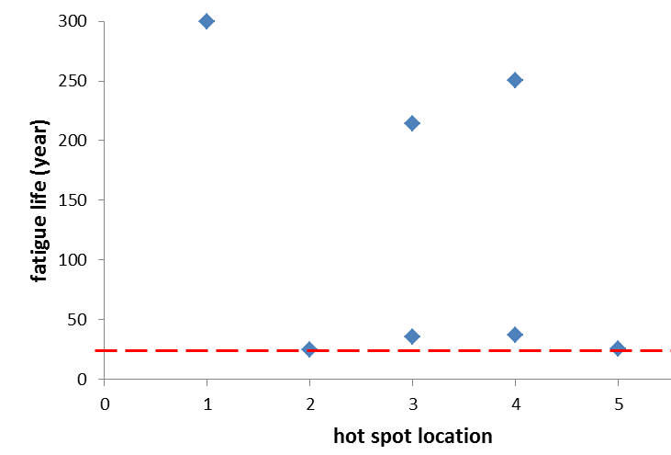
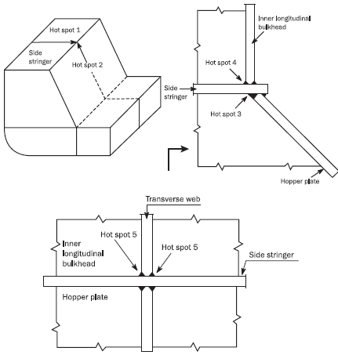
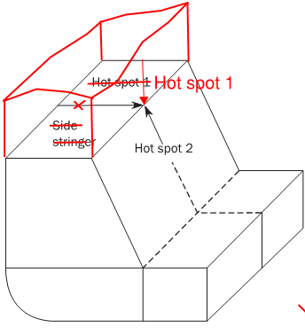
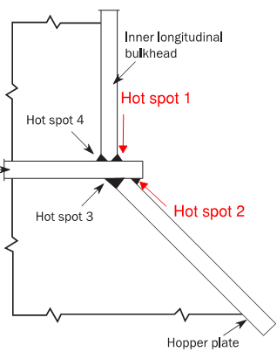
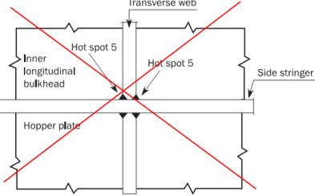
Items to be discussed
Selection of fatigue hot spot locations and hot spot type
Welded upper hopper knuckle
CSR-H 2015
CSR-H 2015
Draft RCP2 2016
Notes:
for welded upper knuckle, the amount of results is not enough to give a conclusion. The results are only for reference.
It is found that the hot spot 1 is not necessary. It is calculated based on CSR-H 2015. In draft RCP2 of 2016, we can see that original hot spot 1 is omitted, and is replaced by original hot spot 5 which changed to another type.

Slide 29




Items to be discussed
Selection of fatigue hot spot locations and hot spot type
Radiused lower hopper knuckle
Notes:
For radiused lower knuckle, the results of hot spot 6 (side girder) are much higher than 25 years, and may be omitted in fatigue assessment. Radiused upper knuckle is not required in fatigue assessment if designed in accordance with detail design standard.

Slide 30

Items to be discussed
Arrangement of hopper web in foremost cargo hold region
  The curved face plate of hopper web frame is hard to satisfy
  New design to avoid stress concentration
  Other optimized design may be considered
a) old design
b) new design
Notes:
Another way to solve the problem is to increase the radius of the curve part and reduce the height of the web plate, but it is not very effective for this narrow space and stress concentration still exists. So it is better to use arrangement b) to avoid high stress level of face plate.

Slide 31
Conclusion
Some new design trends related to demand of eco-friendly or green ship design have occurred for oil tankers, and will provide additional challenges to the structural design, especially when meeting the requirement of new CSR.
The fore ship region has been strengthened due to ice class requirement and lower rate of higher strength steel, and it is found that few areas need to be reinforced for New CSR for foremost cargo hold region.

Slide 32
Conclusion
Several items need to be noted:
  It is suggested that the hull girder shear structural members in engine room are not to be evaluated in cargo hold analysis, or the shear force adjustment method is to be amended.
  There would be different buckling results by different modeling methods. It is suggested that the modeling method of manholes are based on their sizes, and screening criteria for manholes could be adjusted.
  For the new inclined strut arrangement, it is suggested that the shear strength of bottom floor at inboard end shall be checked in the prescriptive requirement with shear stress derived from FEA.
  Some hot spot locations of hopper knuckle could be omitted in the fatigue analysis.
  Large opening may be not necessary for hopper web when the hopper tank is not wide enough.

Slide 33
Thank You for
Your Attention!

